Slide 1
GEHC SDT Weekly Status Report
03/16/17

Slide 2
Open Actions
Action item | Owner | Forum | Expected Closure Date | Actual Closure Date | Owner Comment | Status
Mobility Team or tiger team to be formed to resolve all CLICK mobile issues. | Rohit/Gopi | Jan’ 17 Workout | TBD |  | Debug log mode have been activated on production for 19 FE’s | In Progress
Performance issues: SDT Booking and Architecture Assessment. | Hita/Andrey/Urmila | Jan’ 17 Workout | 28-Feb-2017 |  | Demo held with GE on SDT booking performance improvement areas. | In Progress
Ownership on Tickets/Process adherence(Agile Mechanism) | Suvarna/Sathyaraj | Jan’ 17 Workout | Ongoing |  |  | In Progress
GEHC to check and confirm on L1 support - on call support | Chandra/CG | Jan’ 17 Workout | TBD |  | CG working with GCC team to setup the on call support. | In Progress
CLICK DB access for CG team GE to setup a separate call to discuss | Chandra | WSR meeting | TBD |  | Click team to provide DB dump daily basis on FTP location. | In Progress

Slide 3
Weekly Snapshot – 03/16/17
Health of the Engagement
Highlights
On CRP and iTest we compared the timings of click calls in UI, the time has reduced to 17sec which was earlier 30 secs.
On CRP we reduced geocode calls and we got SDT Load time reduction from around 57 sec to 42 sec.
Implemented indexes instead of dynamic groups and improved performance by 6s to fetch task data earlier it was taking an average of 12Sec.
Testing : Created Test script “OQ_ES_LS_Same” and revised and updated regression script “OQ_System_ID_Blank_Revision_2” in ALM, Performed Dry run for the above 2 scripts.
GREEN
Risk / Issues / Challenges
Help Needed
No access to Click DB(Prod, Stage, Sandbox) may lead to delay in resolving issues
Need resolution to infrastructure related queries and common forum to resolve.
Need support on performance related issues on CLICK side.
Need help from CLICK team on Environment details for further analysis on Mobile sync issue.

Slide 4
Focus Area Updates
Focus Areas | Owner | Status | Comments
Mobile Sync Issues | CG Team | In Progress | Received the artifacts related to debug log configuration file but yet to receive end to end environments details from CLICK team which was requested last week. Scheduled frequent meeting with CG mobile team & discussed on how to activate mobile background mode on IOS device and we are expecting background mode activation documentation. Rohit scheduled a call with Performance testing/ Akana log team to discuss about performance of CLICK Mobile and how to capture log for CLICK Mobile. SDT click team Investigated about CLICK Mobile web service performance locally and provided update to GE..
SDT Booking Performance Issues | CG Team | In Progress | Demo held regarding the improvement areas which team worked on POC and shared that data with GE that includes Reducing google geocode calls. Indexing code changes in SDT Minimizing the click calls in majorly used method that pull data from click. On CRP and iTest we compared the timings of click calls on UI, the time has reduced to 17sec which was earlier 30 secs. On CRP we reduced geocode calls and we got SDT Load time reduction from around 57 sec to 42 sec. Queries are pending regarding architecture assessment with network team.
Release Management | CG Team | Ongoing | Release check list was created and it is updated in our Release readiness check call.
Incident Management | CG Team | Ongoing | Streamlining incidents w.r.t CLICK support cases Problem ticket creation process finalized. Incidents reported in this week are closed.
Support and Development Process streamlining | CG Team | Ongoing | Agile metrics identified and tracked through Rally. Ensuring all email communication to have incident ticket created. Internal defect tracker is maintained to track the QA/UAT defects and owners defined for each defect.

Slide 5

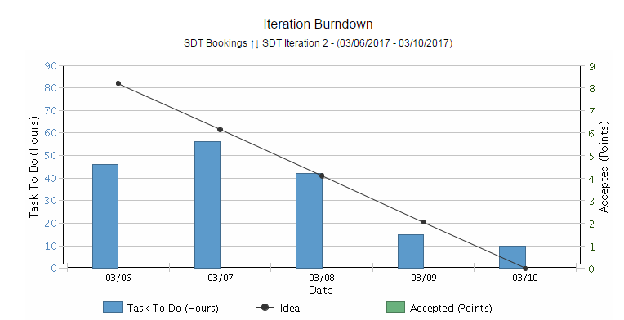
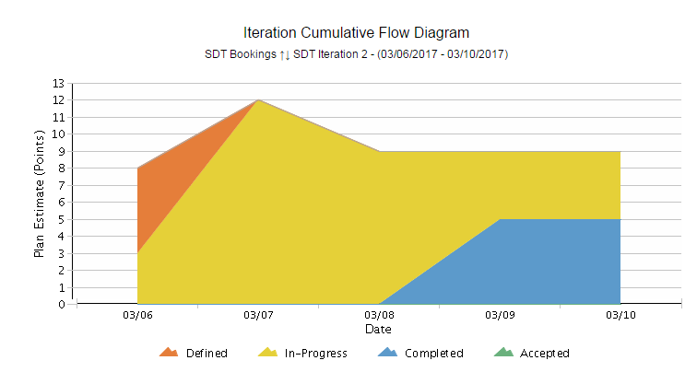
Agile Metrics
R1.3.1 is in Staging environment.
R1.3.1 Captured following user stories
Defect found in R1.3 - System ID popup Issue
US 97 – Improving Logging Mechanism
US 85 – ES & LS same
Iteration Burndown Chart:
Short Sprint for analysis on technical user stories helped us in getting faster feedback from Product owner.
Prioritized users stories by Product owner based on the performance analysis.
Iteration Cumulative Flow Diagram
At start of the sprint some of the task are in defined state and started working on some of the tasks from user story which shows In progress state.
At the end of the iteration completed all the performance analysis user stories covered and sent for acceptance approval.
SDT Iteration 2 - 6th Mar to 10th Mar ‘17
Inferences
Inferences

Slide 6
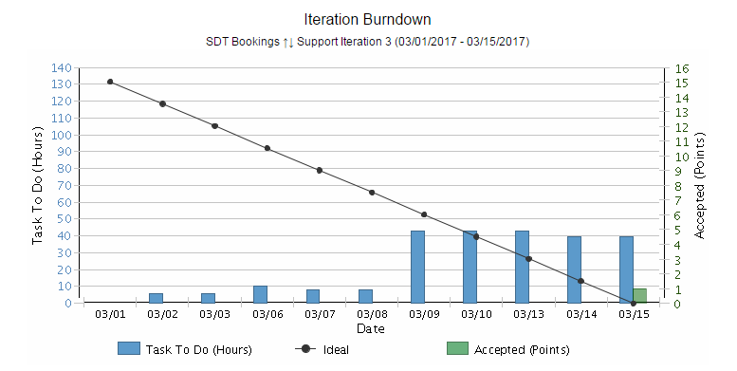
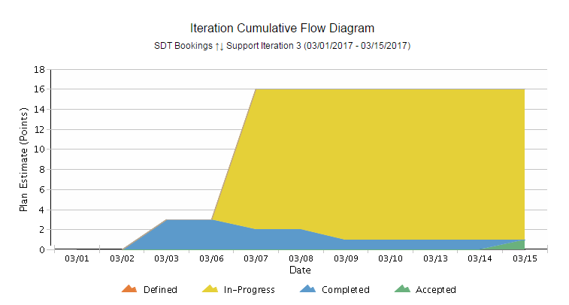
Agile Metrics
SDT Click, Support and Incidents
Support Iteration 3 - 1st Mar to 15th Mar ‘17
Inferences
Iteration Support Burndown Chart:
Support activities keep on added up on a daily basis based on the support tickets that we receive. Hence there’s a mismatch with ideal.
End of the sprint, all tickets are closed and all the user stories are accepted by Product owner.
Iteration Cumulative Flow Diagram
Most of the tickets like Mobile Sync issues,R21. and R2.2 activities are completed.
Some of the incident tickets are in-progress due to Awaiting 3rd party(Click).
Mobile Sync issues are still in progress and will be continuing with next iteration.

Slide 7
Agile Metrics – Velocity Chart

Slide 8
Agile Metrics – Resource Utilization

Slide 9
Incident Update
9 incident tickets are resolved/closed
4 Awaiting 3rd party – 3 with Siebel; 1 with Click
3 Awaiting User Info
Inferences

Slide 10
Incident Tickets
Incident Management
Incident # | Module | Key Words | Status | Problem # | Queue Wait time
INC1370193 | SDT Mobile | Mobile sync Issue | Awaiting 3rd Party | NA | 3 months ago
INC1435961 | SDT Mobile | Mobile sync Issue | Awaiting 3rd Party | NA | 2 months ago
INC1446914 | SDT Mobile | Mobile sync Issue | Awaiting 3rd Party | NA | 2 months ago
INC1447037 | SDT Mobile | Mobile sync Issue | Awaiting 3rd Party | NA | 2 months ago
INC1447060 | SDT Mobile | Mobile sync Issue | Awaiting 3rd Party | NA | 2 months ago
INC1454094 | SDT Mobile | Mobile sync Issue | Awaiting 3rd Party | NA | 2 months ago
INC1463913 | SDT Mobile | Mobile sync Issue | Awaiting 3rd Party | NA | a month ago
INC1464027 | SDT Booking | Click Issue | Awaiting User Info | NA | 6 weeks ago
INC1477114 | SDT Booking | Mobile Sync Issue | Awaiting User Info | NA | a month ago
INC1480772 | SDT Mobile | Mobile sync Issue | Awaiting User Info | NA | a month ago
INC1480941 | SDT Mobile | Mobile Validation Issue | Awaiting 3rd Party | NA | a month ago
INC1735928 | SDT Schedule | Click Issue | Awaiting 3rd Party | NA | 14 days ago
INC1736222 | SDT Schedule | Click Issue | Awaiting 3rd Party | NA | 14 days ago
INC1738700 | SDT Module | Click Issue | Awaiting 3rd Party | NA | 13 days ago
INC1742931 | SDT Module | Click Issue | Awaiting 3rd Party | NA | 10 days ago
INC1747182 | SDT Mobile | Click Issue | Awaiting 3rd Party | NA | 9 days ago
INC1752971 | SDT Schedule | Click Issue | Awaiting User Info | NA | 7 days ago
INC1753433 | NA | NA | Awaiting User Info | NA | 6 days ago
INC1754593 | SDT Mobile | Mobile Sync | Awaiting 3rd Party | NA | 6 days ago
INC1754642 | SDT Mobile | Mobile Sync | Awaiting 3rd Party | NA | 6 days ago
INC1754875 | SDT Mobile | Mobile Sync | Awaiting 3rd Party | NA | 6 days ago
Problem Management
Problem # | Module | Keyword | Status | Incident #
PRB0045855 | SDT Booking | Google API | Open | INC1371682, INC1389372, INC1357120
PRB0045895 | SDT Booking | Email Activity | Open | INC1285226
PRB0045475 | SDT Booking | Performance - Connectivity | Known Error / Pending CA | INC1310582

Slide 11
THANK YOU

